Slide 1
From Noise to Clarity
Leveraging Health Models in Azure Monitor
PREVIEW SLIDE DECK – CHANGES EXPECTED BEFORE SESSION

Slide 2
Attention
MMS sessions are 60-75 minutes followed by LONG Q&A
Please hold detailed questions until that Q&A starts
Feel free to ask clarification questions
Remind the speakers to use Zoom It when you can’t see

Slide 3

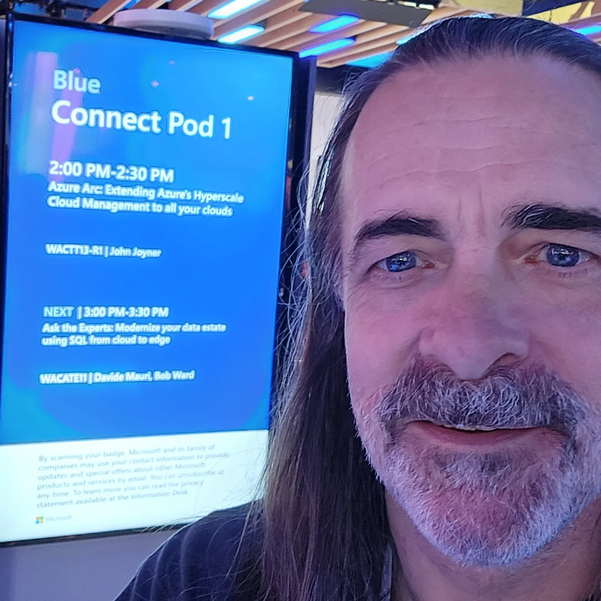

Brian Wren
John Joyner
Microsoft
https://accountabilIT.com
BrianWren
in/BrianWrenLB
fawkes2
in/ johnjoyner

Slide 4
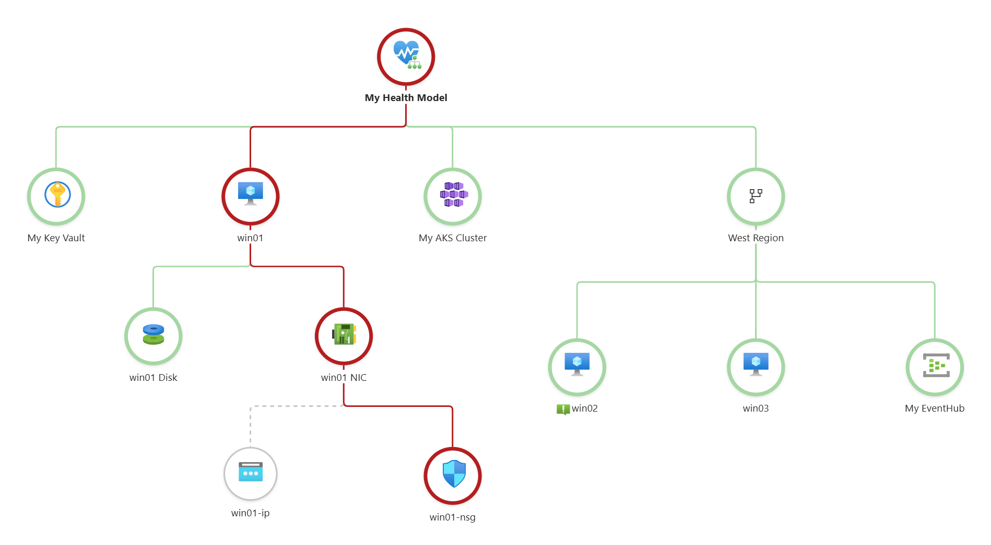
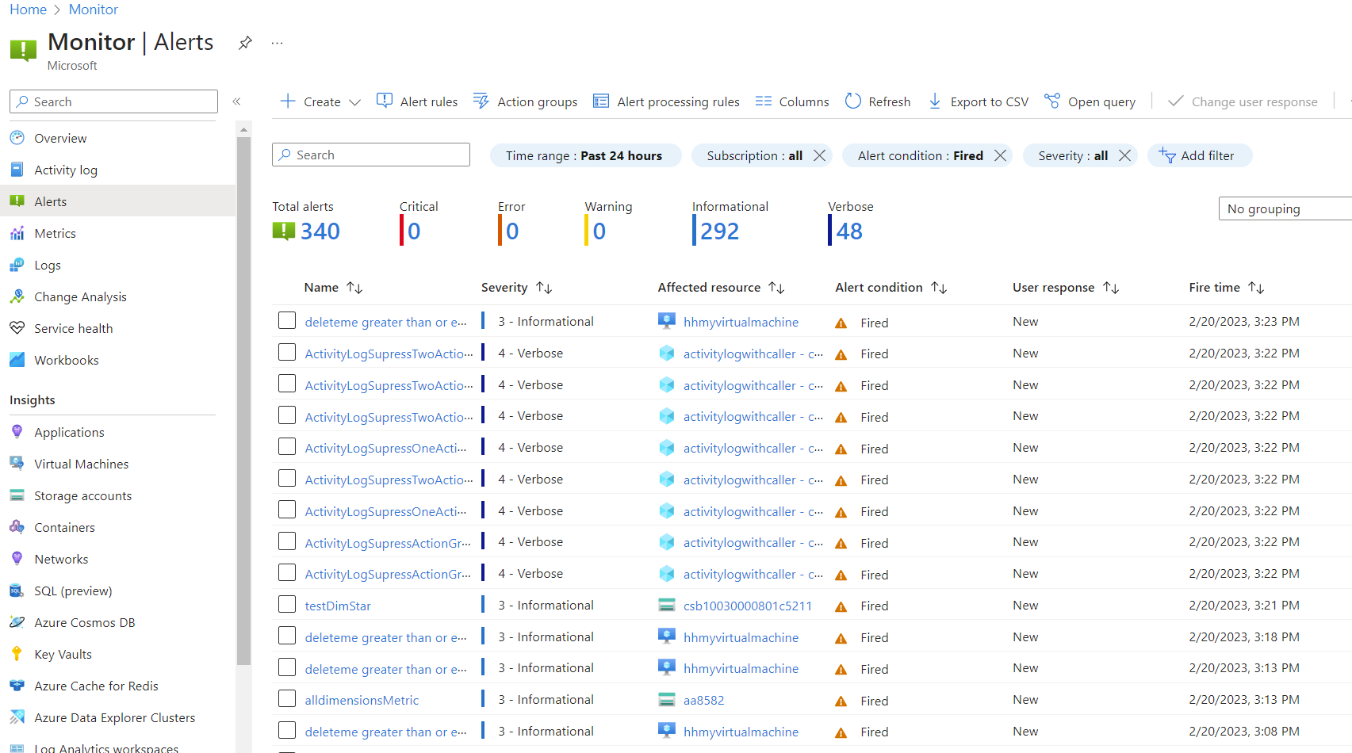
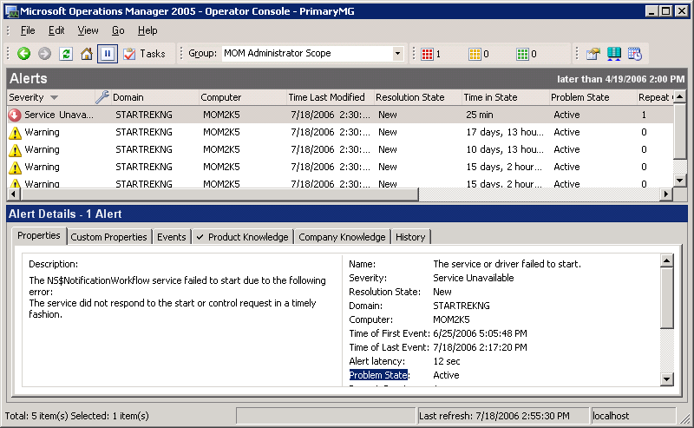
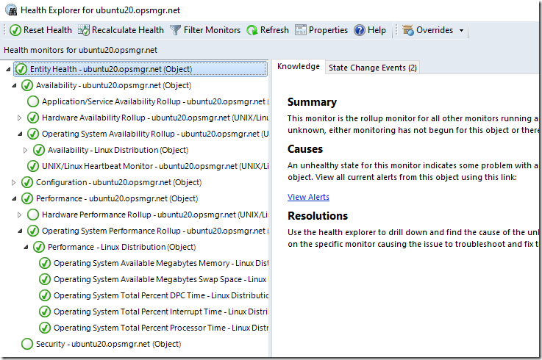
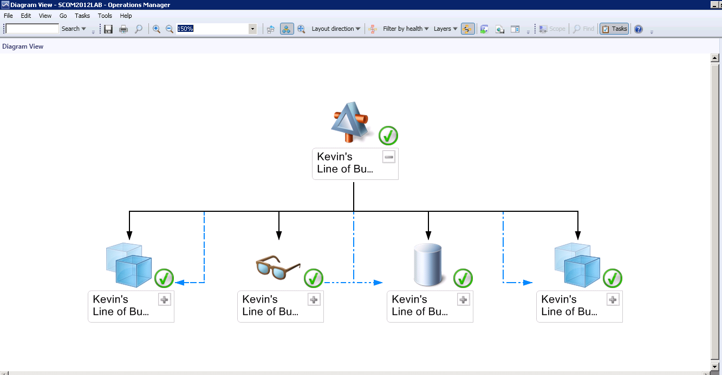
Monitoring Timeline
2000
MOM 2000
Collect data and fire alerts
Monitors
Health State
Relationships
2007
SCOM 2007
2018
Azure Monitor
Collect data and fire alerts
Monitors
Health State
Relationships
2025
Health Models

Slide 5
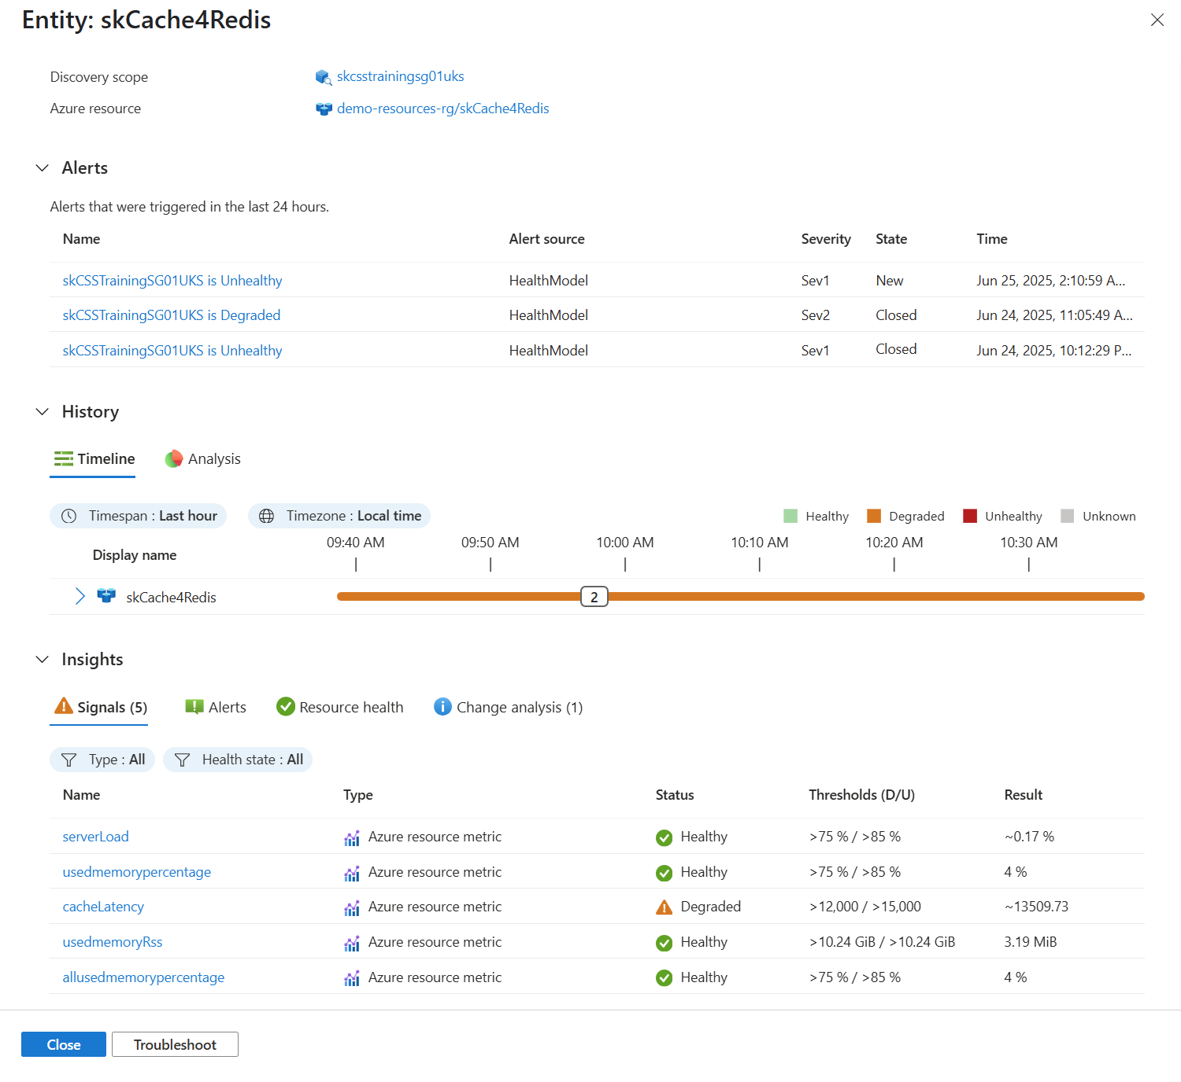
Why Health Models
Raw telemetry is technical, high volume, and hard to prioritize
Health Models add business context to Azure Monitor signals
Track workload/application health as a rollup of component health
Reduce alert noise by alerting on health state transitions

Slide 6

Entity types
Root Single top-level workload entity
Azure resource Manually add or auto-discover
Generic Manual entity for business process or aggregation

Slide 7
Relationships and rollup
Relationships define dependency and aggregation
Child state propagates to parent health
Multiple parents and children are supported

Slide 8
Demo
Entities
Relationships

Slide 9
Signals
Health model does not collect data; it interprets collected data
One or more signals per entity
Thresholds define degraded and unhealthy boundaries
Type | Description
Azure resource | Metrics from specific Azure resource. Recommended signals available.
Log Analytics workspace | KQL query and thresholds
Azure Monitor workspace | PromQL query and thresholds

Slide 10
Health states
States
Healthy
Degraded
Unhealthy
Unknown
Entity state uses worst signal state.
Server errors
Incoming messages
Throttled Requests
My Event Hub

Slide 11
Health propagation
Standard (Default)
Limited
Suppressed
Worst of (Default)
Minimum healthy
Maximum not healthy
Impact (Bottom up)
Dependencies configuration

Slide 12
Demo
Signals

Slide 13
Alerting strategy with Health Models
Alert on entity state changes
One health alert can represent multiple failing signals
Use root alerts for business impact visibility
Use entity-level alerts for operator action and triage
Server errors
Incoming messages
Throttled Requests
Alert only on state change
My Event Hub

Slide 14
Reusable signals
Recommended automatically available
Create your own reusable signals
Automatically assign in discovery

Slide 15
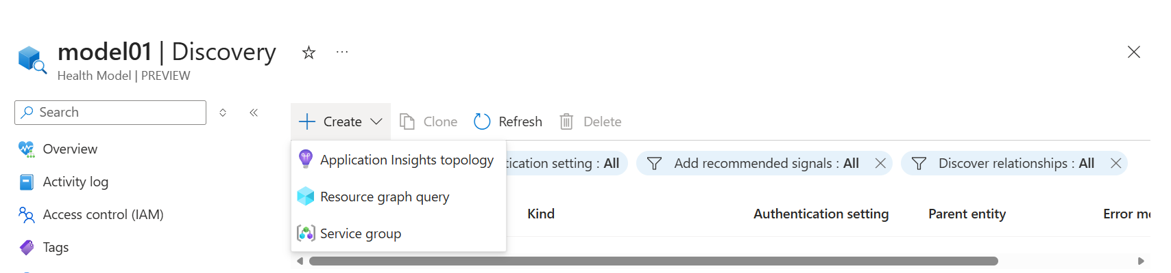
Auto discovery
Dynamically add Azure entities to model
Runs every 5 minutes
Define parent entity and discover potential relationships
Add recommended signals for resource type

Slide 16
Demo
Discovery Signal definitions

Slide 17
Operational views
Category | View | Description
Edit | Designer | Primary editor for relationships and signal definitions
 | Entities | Fast filter/edit for unconfigured entities
 | Discovery | Service group and auto-discovery settings
 | Signal definitions | Inspect and remove unused definitions
 | Authentication settings | Identity per entity/data source access
Analyze | Graph | Current snapshot and visual representation of dependencies
 | Timeline | Health trends and drill into time slices
 | Entity details | Current signals, alerts, history, and analysi

Slide 18
Demo
Views

